Slide 1
Employee Attrition
Bodie Franklin

Slide 2
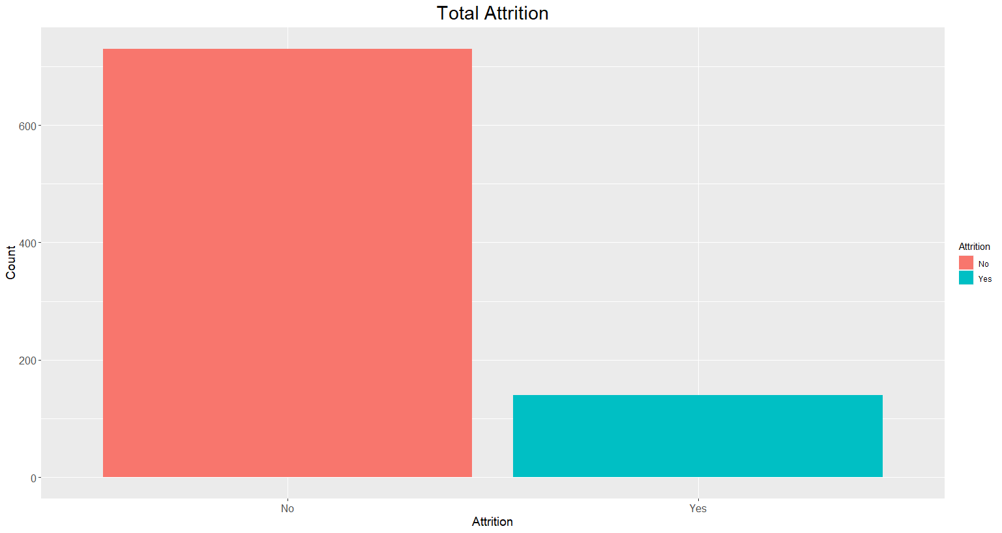

Slide 3
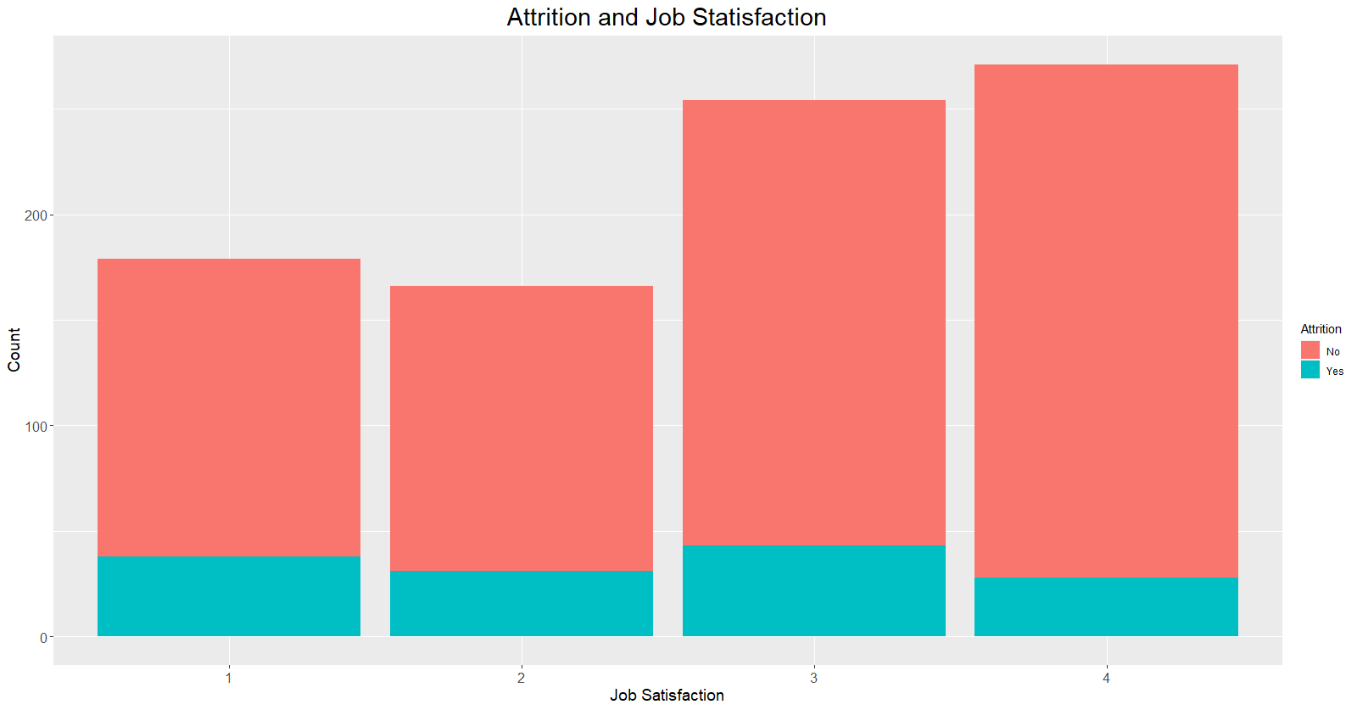

Slide 4
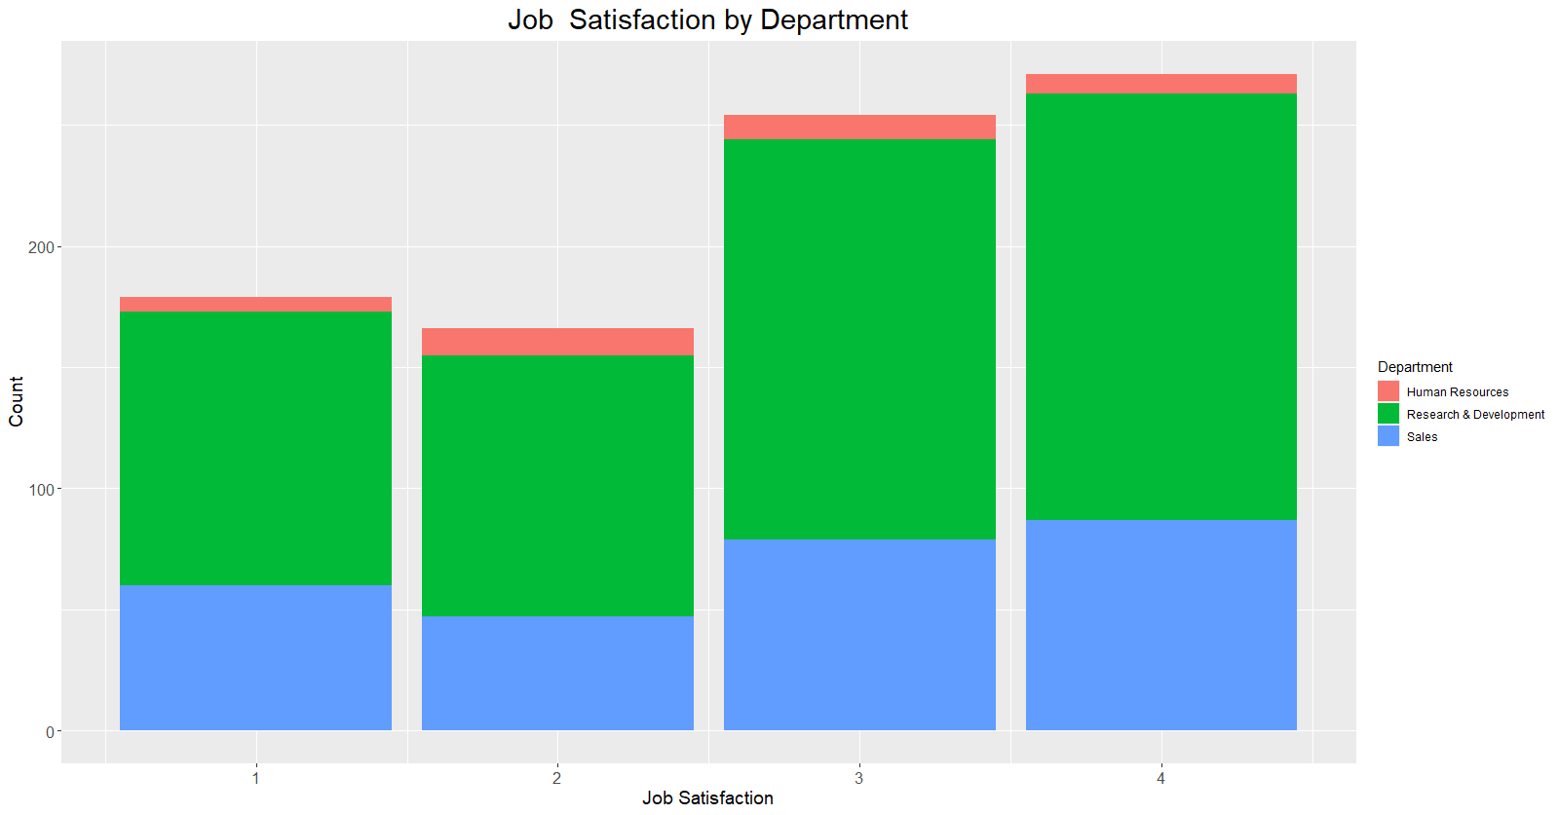

Slide 5
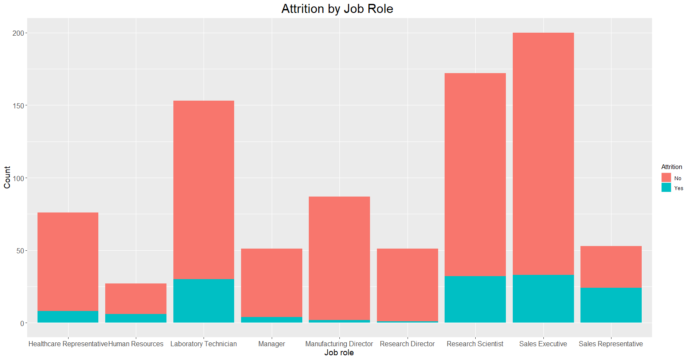

Slide 6
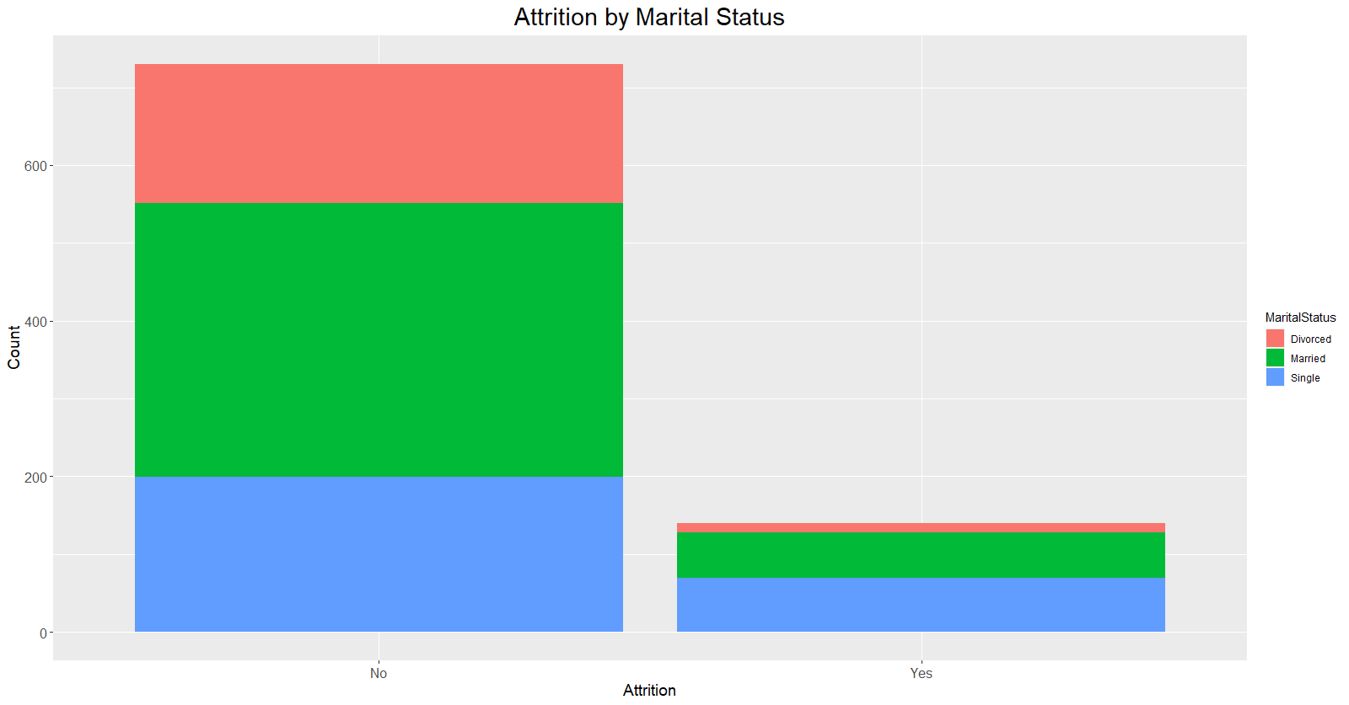

Slide 7
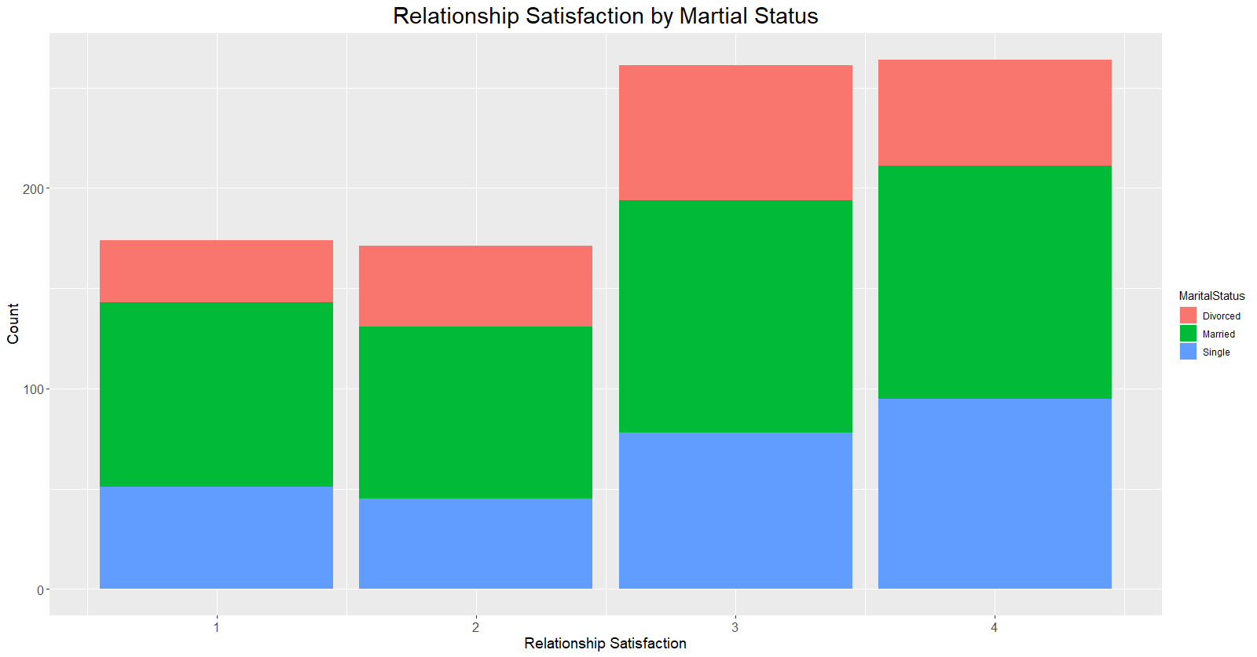

Slide 8
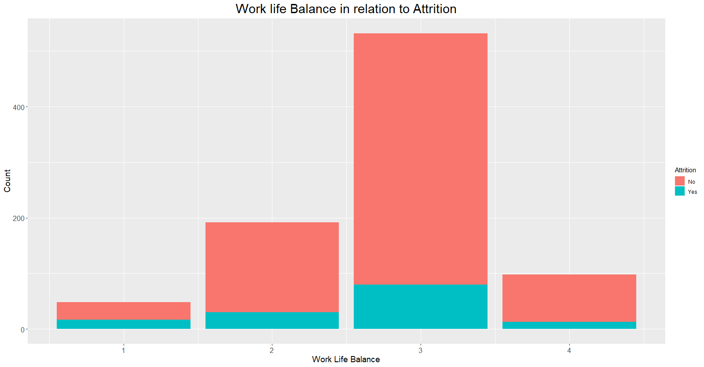

Slide 9
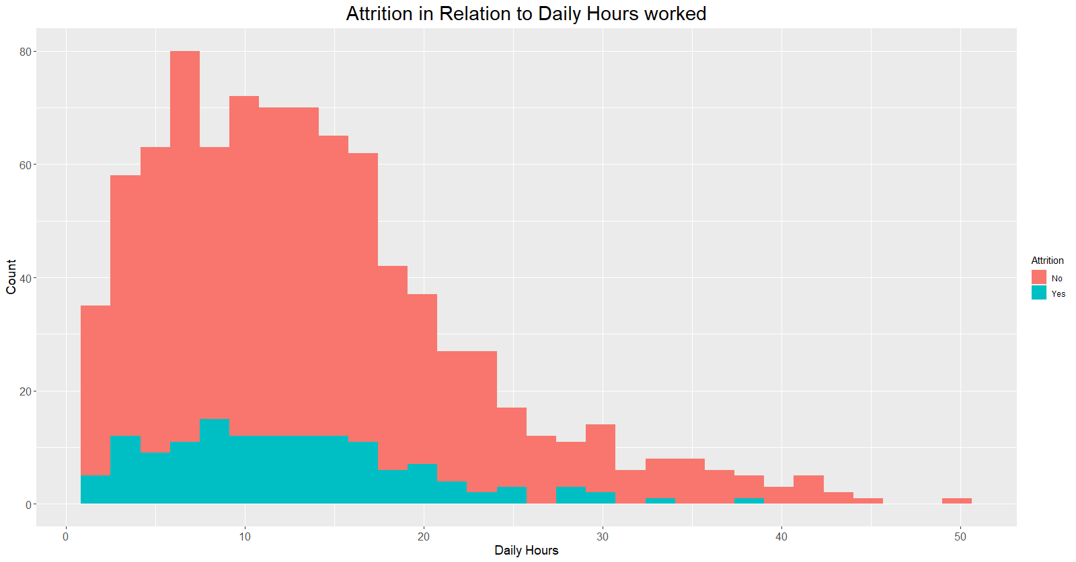

Slide 10
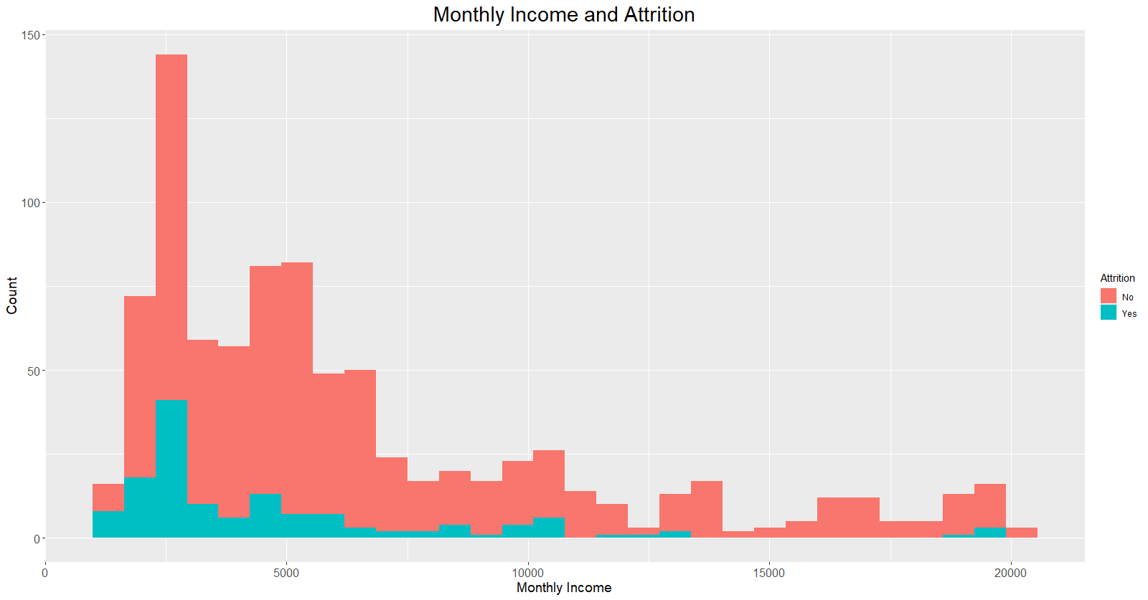

Slide 11
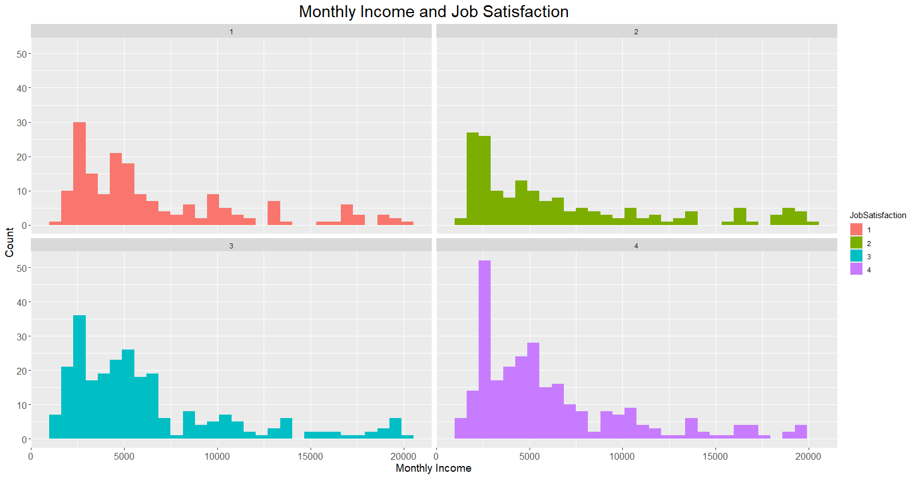

Slide 12
Predicting Attrition | Variables | Accuracy | Sensitivity | Specificity
KNN | Business Travel Years at the Company Martial Status | 0.84 | 0.84 | 0.72
Naïve Bayes | Business Travel Years at the Company Martial Status | .83 | 1.00 | 0
Random Forest | Monthly Income Over Time Monthly Income Age | .83 | .98 | .16

Slide 13
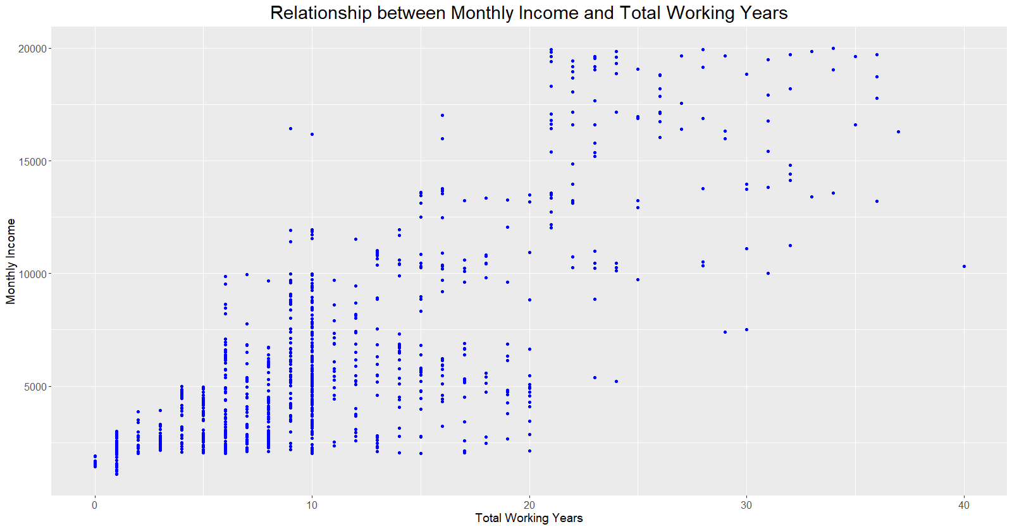

Slide 14
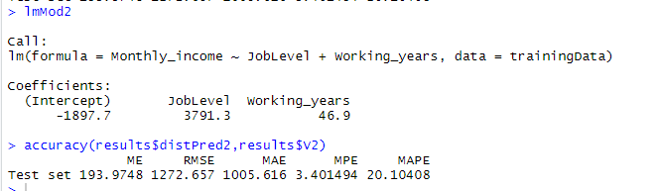
Linear Model to Predict Monthly Income

